Slide 1




ESFT : Propulsion Team
Solid Propellant Propulsion
Rebecca Tobin
tobinr@erau.edu
Mentor: Dr. Brenda Haven

Slide 2

Outline
Propellant
Characterization
Previous Geometry Design
Current Geometry Design
Casting Methodology
Future Objectives

Slide 3
Current Propulsion Team Mission
Design an optimized grain geometry to match a desired thrust profile
Design a casting method
Static Fire and compare theoretical and experimental data

Slide 4
Solid Propellant
Current Formula:
72% Ammonium Perchlorate
  Allows a castable form of propellant, which allows the manufacturing of desired geometries
7% Aluminum
  High Energy Fuel
2% Oxamide
  Burn Rate Reduction
14.08% HTPB
  Hydroxyl-terminated Polybutadiene- Elastomer Binder
2.12% E-744
  Curing Agent
1.8% IDP
  Inosine Diphosphate

Slide 5
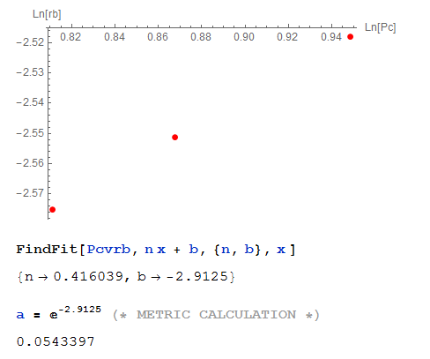
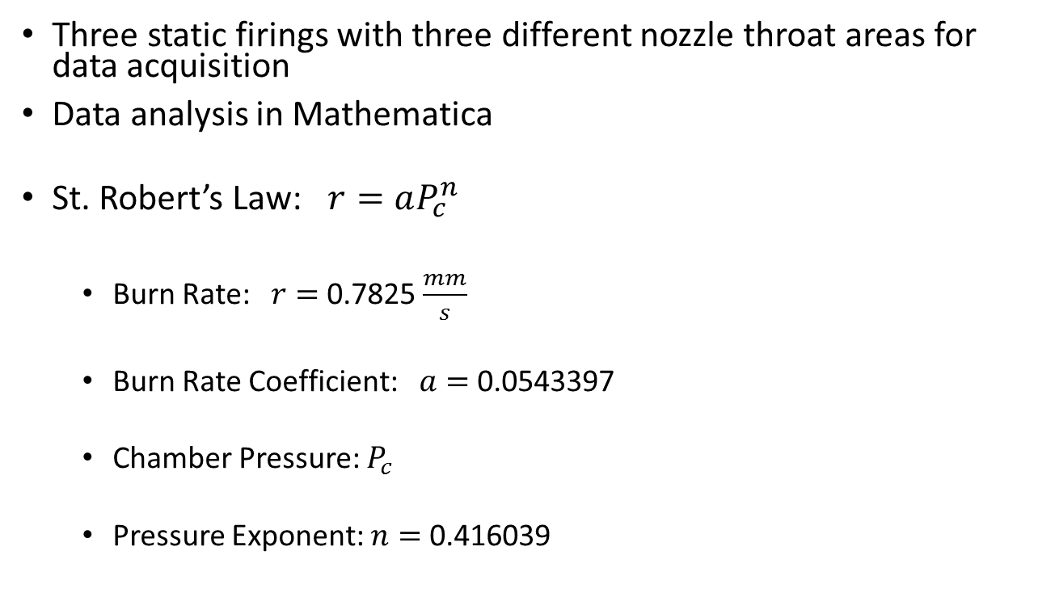
Characterization
Three static firings with three different nozzle throat areas for data acquisition
Data analysis in Mathematica
St. Robert’s Law: $r=aP_{c}^{n}$
  Burn Rate: $r=$ 0.7825 $\frac{mm}{s}$
  Burn Rate Coefficient: $a=$ 0.0543397
  Chamber Pressure: $P_{c}$
  Pressure Exponent: $n=$ 0.416039

Slide 6
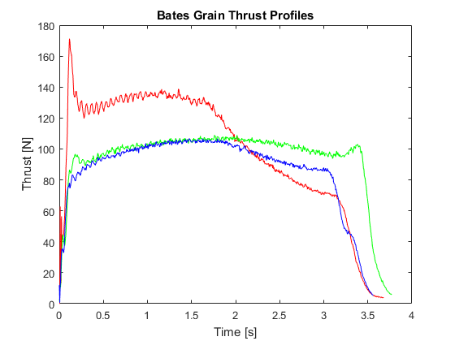
Previous Grain Geometry
Multiple grains, three different nozzle throat areas tested
Bates Grain Geometry (tubular)

Slide 7
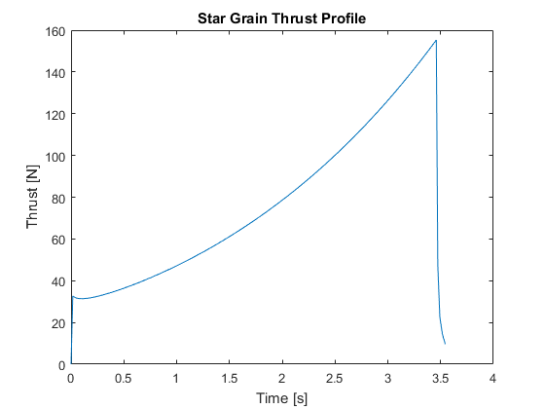
Optimized Grain Geometry
Desired thrust profile wanted an initial spike followed by a progressive burn
Developed a MatLab code to run through a star grain geometry with variable parameters for optimization

Slide 8
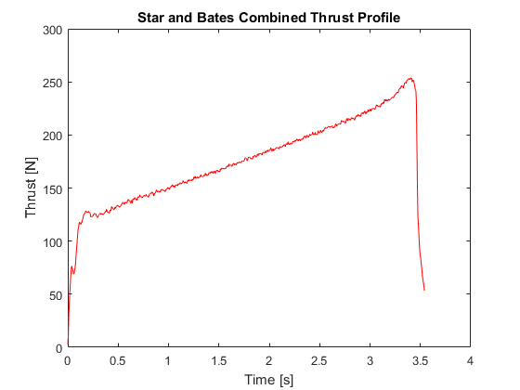
Combined Geometries
Desired thrust profile required a larger initial spike
Combined a bates grain and an optimized star grain

Slide 9
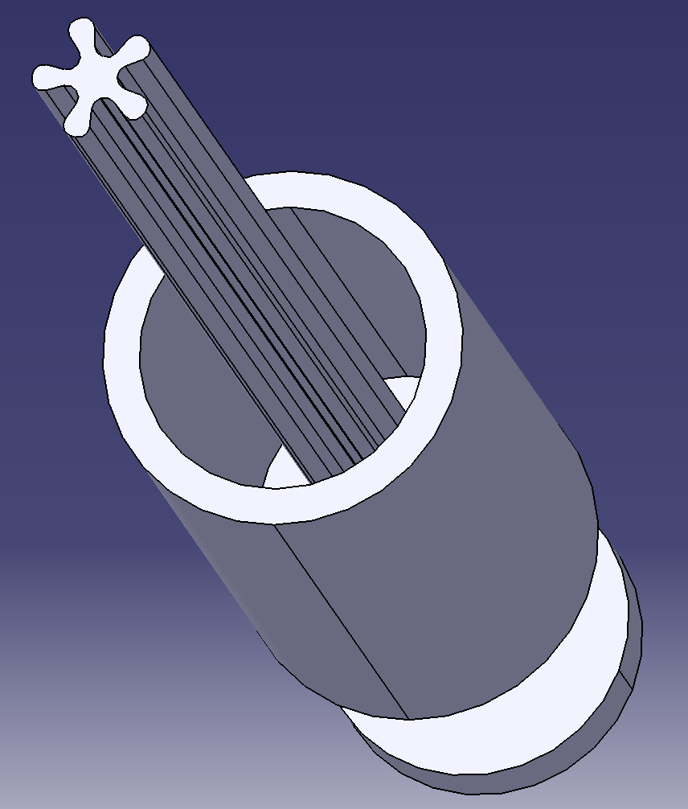
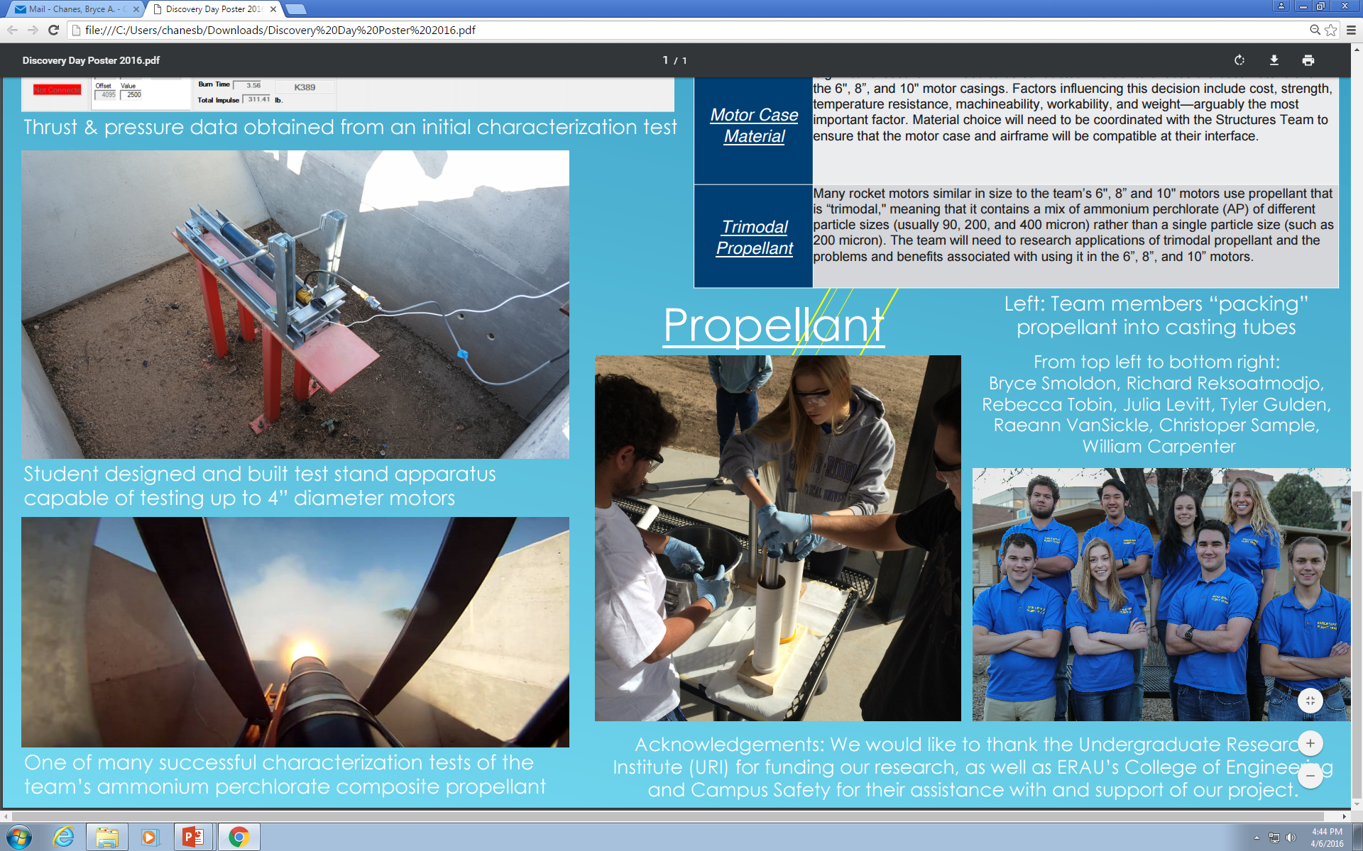
Casting Methodology
Casting Cup
Removable Bore
Removable Cap
Removable Base

Slide 10
Propulsion Testing
Motors placed in a liner
Liner placed in casing
Forward and aft closures are sealed with O-rings
Fully assembled motor is mounted and static fired

Slide 11
Future Objectives
Larger propulsion system scaling
Optimizing nozzle geometry
6in diameter flight motor

Slide 12
Acknowledgements
Dr. Gary Yale – ERAU Space Grant Coordinator
Dr. Brenda Haven – Project Mentor
Dr. Michael Fabian – Guidance
Undergraduate Research Institute

